Slide 1



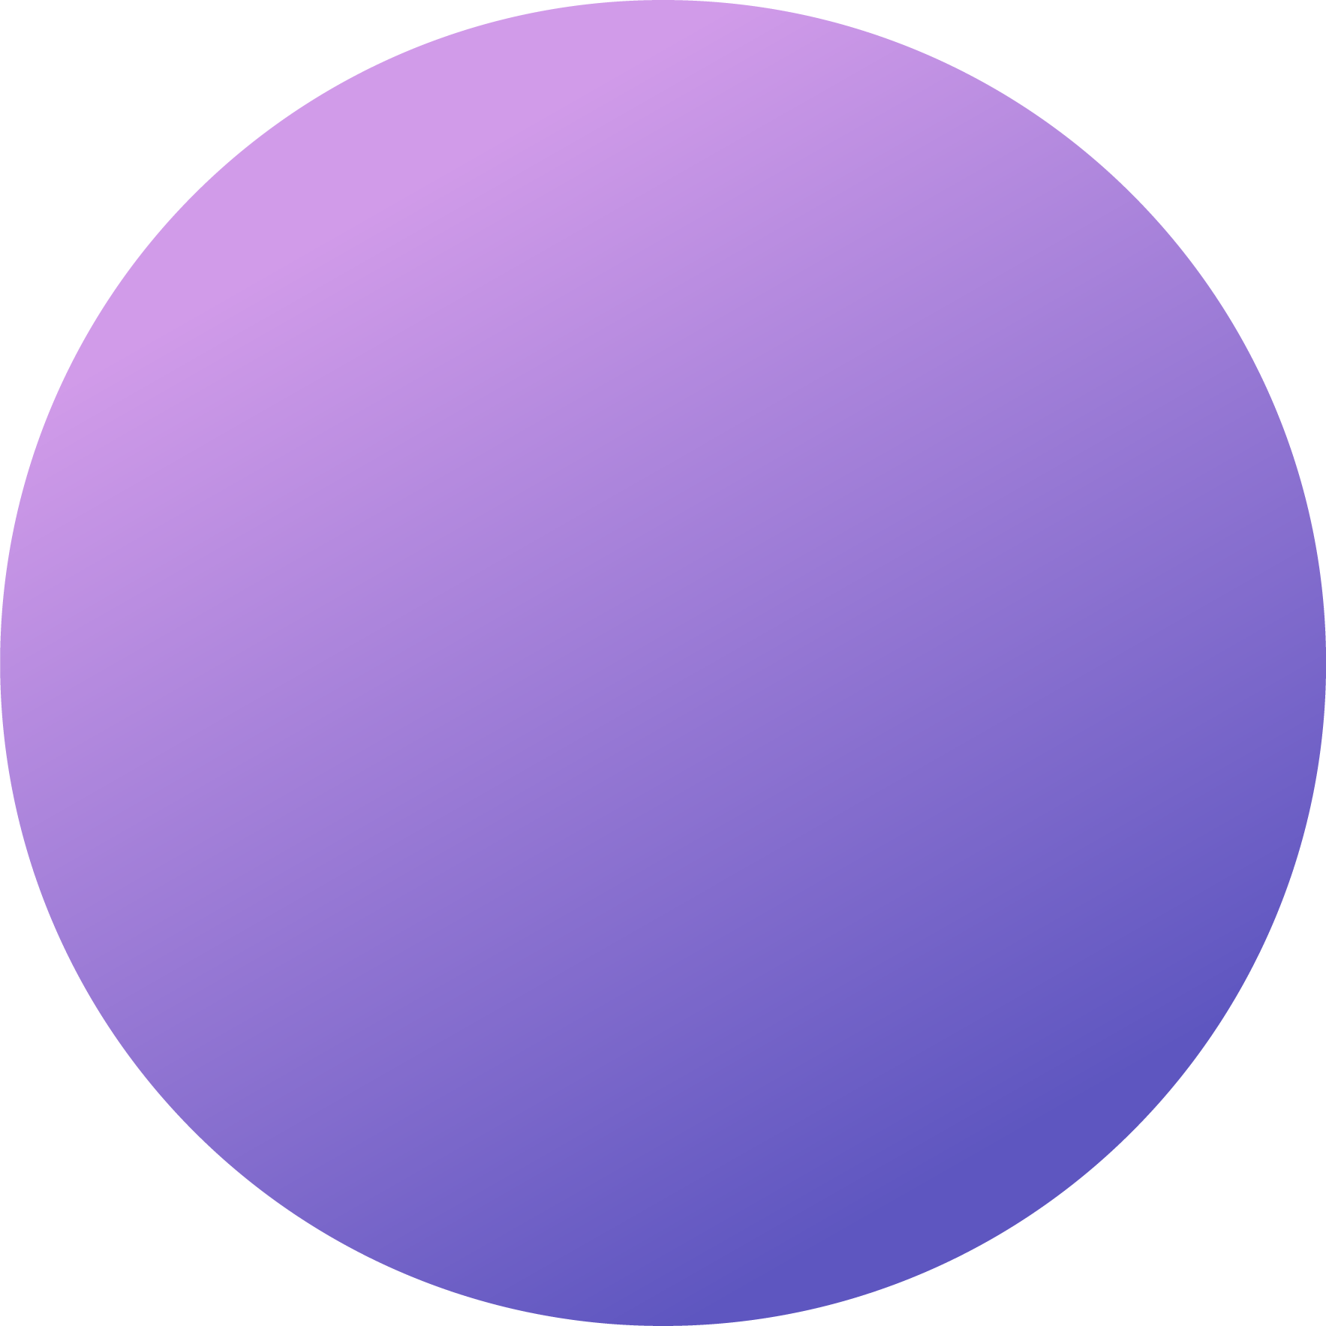

“WEATHER MONITORING STATION”
USING IOT AND CLOUD COMPUTING
CS-IOT-3B

Slide 2

PROBLEM STATEMENT
In many rural and urban areas, there is a lack of real-time, accurate, and localized weather data. This impacts agriculture, urban planning, disaster management, and daily decision-making. Most existing weather stations are expensive, limited in number, or provide delayed updates, making them inaccessible for small communities or individuals. Hence, there is a need for a cost-effective, easily deployable, and real-time weather monitoring station.

Slide 3

PROPOSED SOLUTION
The proposed solution is a low-cost, IoT-based weather monitoring station that gathers real-time environmental data such as temperature, humidity, air pressure, and rainfall. This system will leverage various sensors connected to NodeMCU, which transmits the data to the cloud via Wi-Fi. The data can be accessed by users through ThingSpeak, providing real-time weather updates and historical trends.
This system can be installed in multiple locations to provide localized weather insights, with the potential to integrate with national or global weather networks. The data gathered can help farmers, city planners, or the general public make informed decisions.

Slide 4
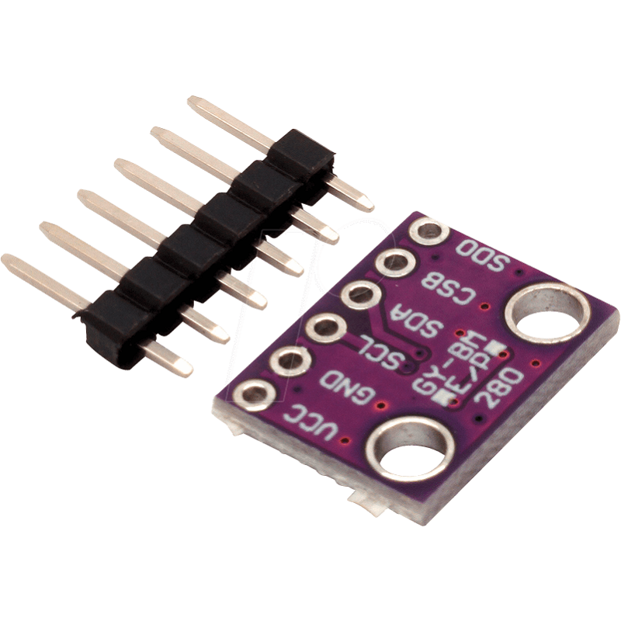
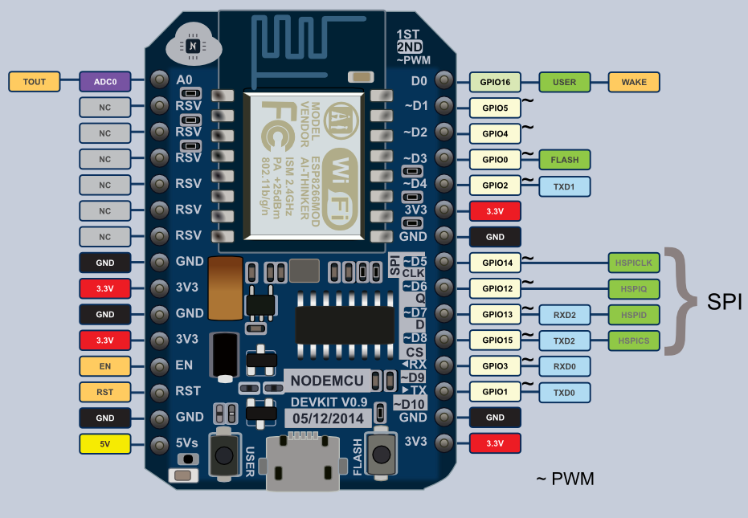
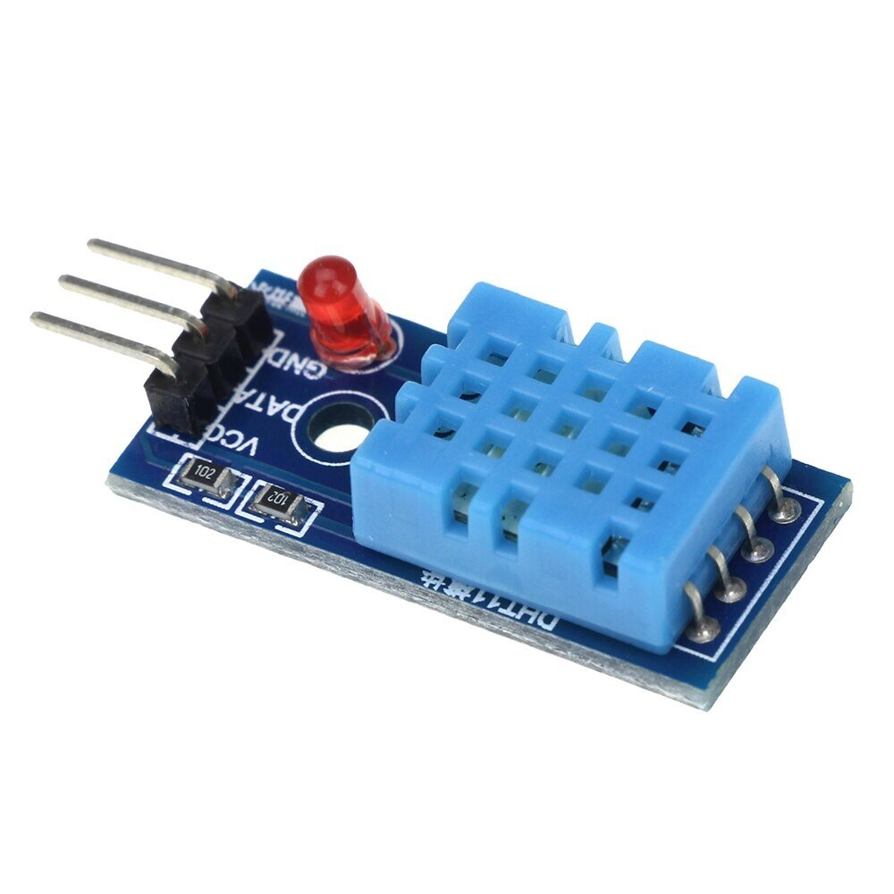
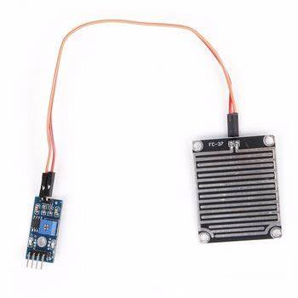
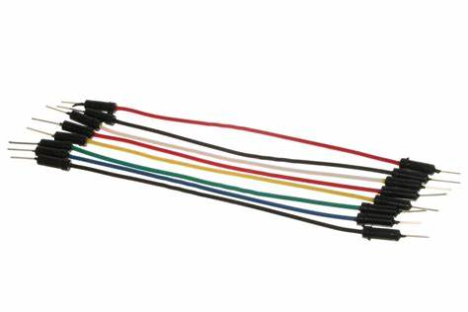
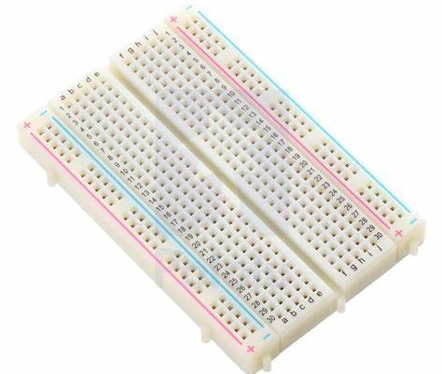
COMPONENTS USED
HARDWARE REQUIREMENTS :
NODE MCU
BMP SENSOR
DHT11 SENSOR
RAIN SENSOR
JUMPER WIRES
BREADBOARD

Slide 5
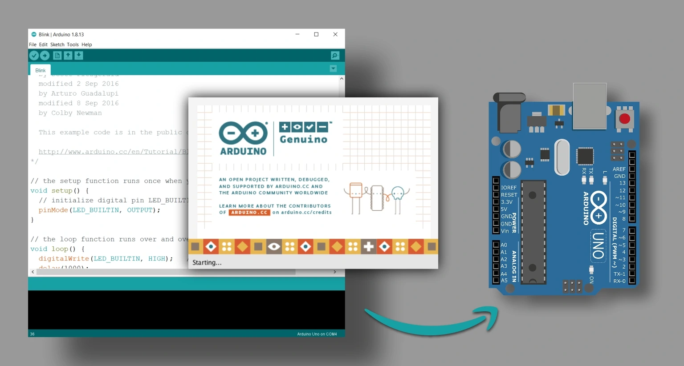
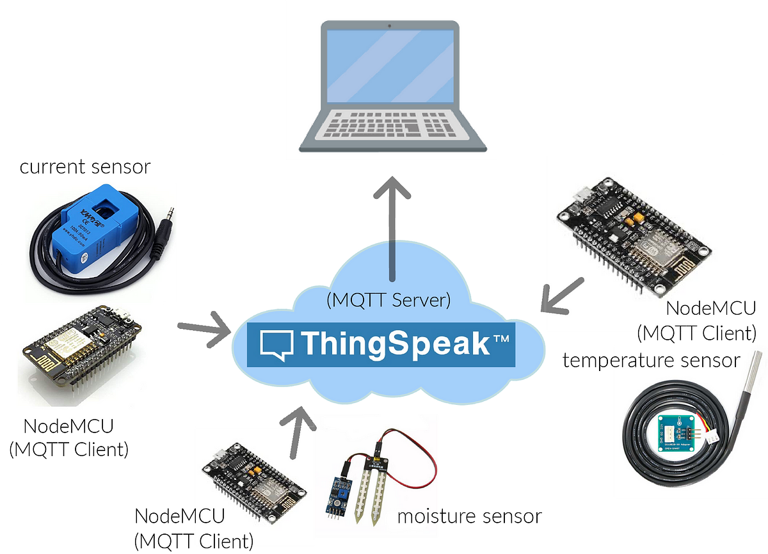
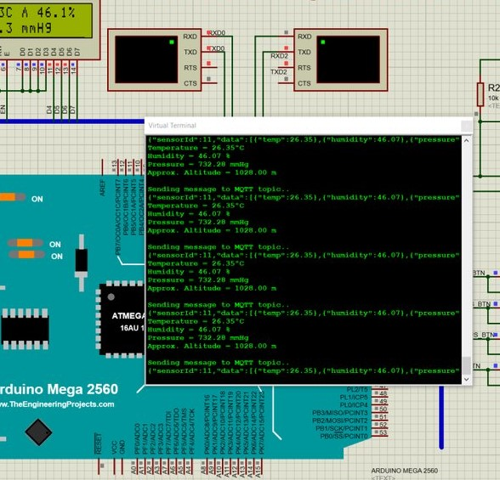

COMPONENTS USED
SOFTWARE REQUIREMENTS :
ARDUINO IDE
THINGSPEAK
PROTEUS
(Iot Circuit Simulator)
VS CODE

Slide 6

ADVANTAGES
Real-Time Data Collection and Visualization: The system provides instant access to real-time weather data through an app or web dashboard.
Low-Cost and Scalable: Designed using cost-effective components, making it accessible for individuals, farmers, or small communities. It can be easily scaled by deploying multiple units across different areas.
Custom Alerts: Users can set threshold values (e.g., for high temperature or humidity) and receive alerts via SMS or email when the weather crosses those limits, improving proactive decision-making.
Solar-Powered Option: To promote sustainability, the station can be designed to be powered by solar energy, enabling remote installations without access to a power grid.
Data Logging and Analytics: Historical weather data is stored in the cloud, providing trend analysis and forecasts based on past data.
Modular Design: The system can easily be upgraded by adding additional sensors (e.g., for air quality, wind speed) or integrating new technologies like machine learning for weather prediction.

Slide 7
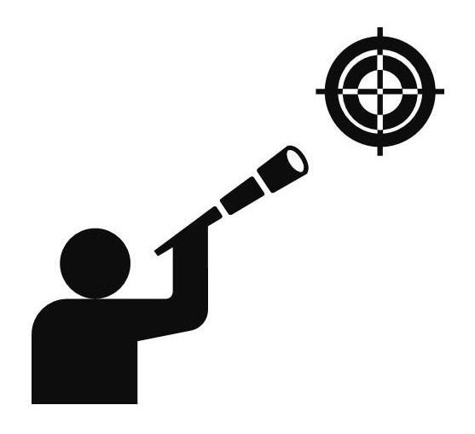
FUTURE SCOPE
Integration of Advanced Sensors: Integrate more advanced sensors to measure additional parameters like UV index and soil moisture which is helpful in agriculture.
Mobile Application: Design a software connected with our hardware which will provide users with real-time updates and alerts.
Solar-Powered Stations: Use solar panels to power the weather monitoring station, making it more sustainable and environment friendly.
Collaboration with Educational Institutes: Partner with institutes and colleges for educational purposes and new ideas for our project.

Slide 8

CONCLUSION
In conclusion, this Weather Monitoring Station project successfully demonstrates the ability to monitor and record essential meteorological data such as temperature, humidity, wind speed, and atmospheric pressure in real-time. By using modern sensors and data processing techniques, the system provides accurate and timely weather information, which can be useful for various applications, from agriculture to urban planning.
The implementation of this system not only enhances our understanding of weather patterns but also equips communities with tools for better decision-making in response to environmental changes. Moving forward, the project could be further developed by integrating advanced features like long-term forecasting, remote access via IoT, and data visualization, making it even more valuable for climate research and practical applications.

Slide 9
TEAM MEMBERS
RAJAT SRIVASTAVA (TEAM LEADER)
Web Developer, ensuring projects meet their goals and objectives.
DEEPANSH MISHRA
A Software Developer in crafting innovative software solutions.
YASH KUMAR
A Hardware Assembler for creating functional systems.
SHRASTI RAJPOOT
A Data Analyst for transforming raw data into actionable insights.
ITI PURWAR
A System Tester to ensure the quality and reliability of project.

Slide 10

THANK YOU !

